Slide 1

Quizi

Slide 2


Slide 3
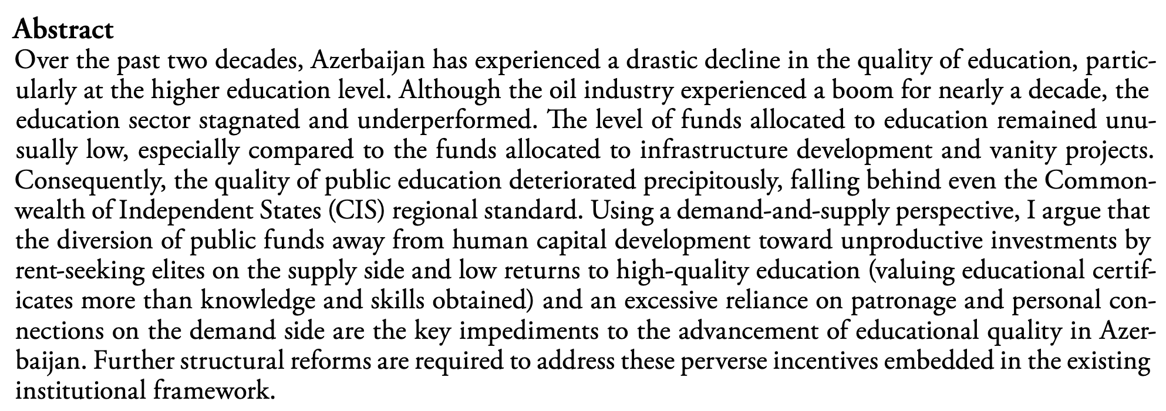

Slide 6
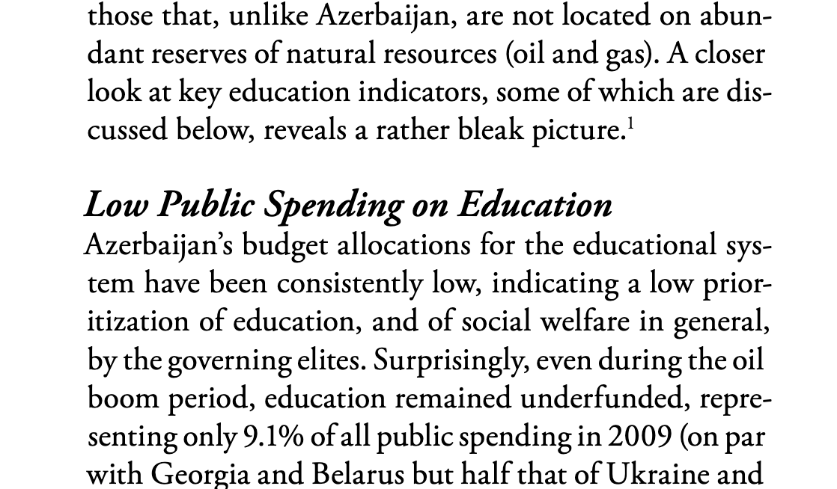

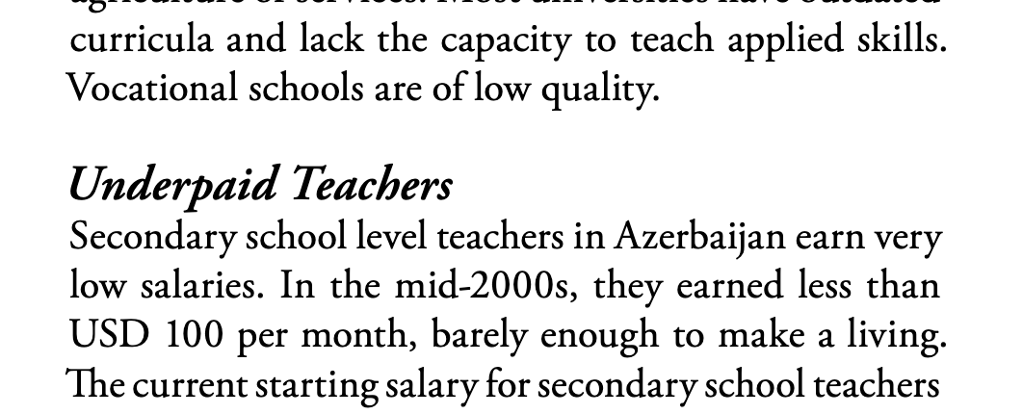
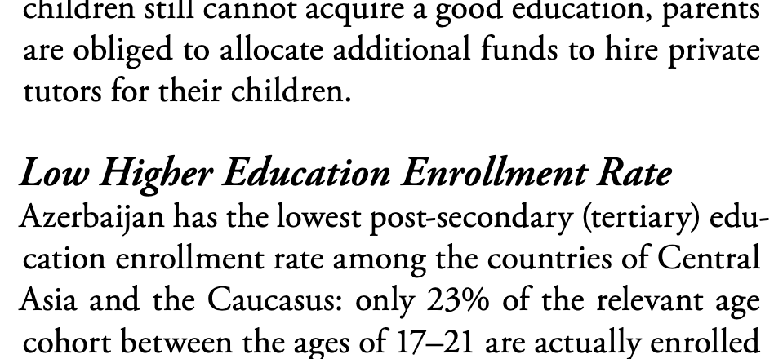
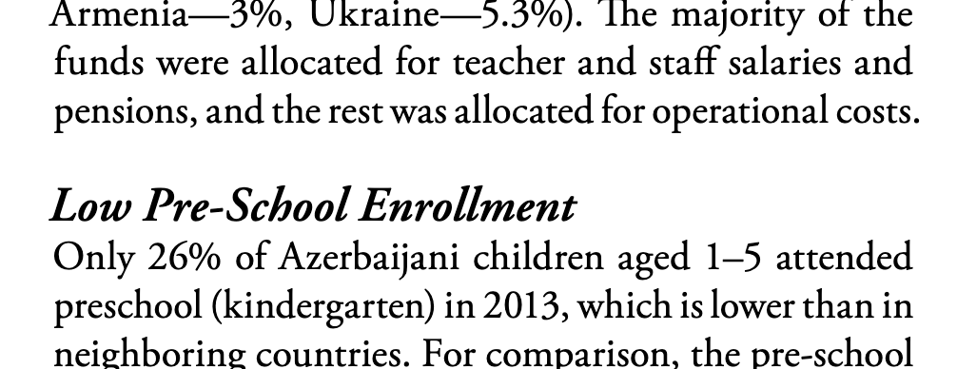

Slide 7


Slide 8
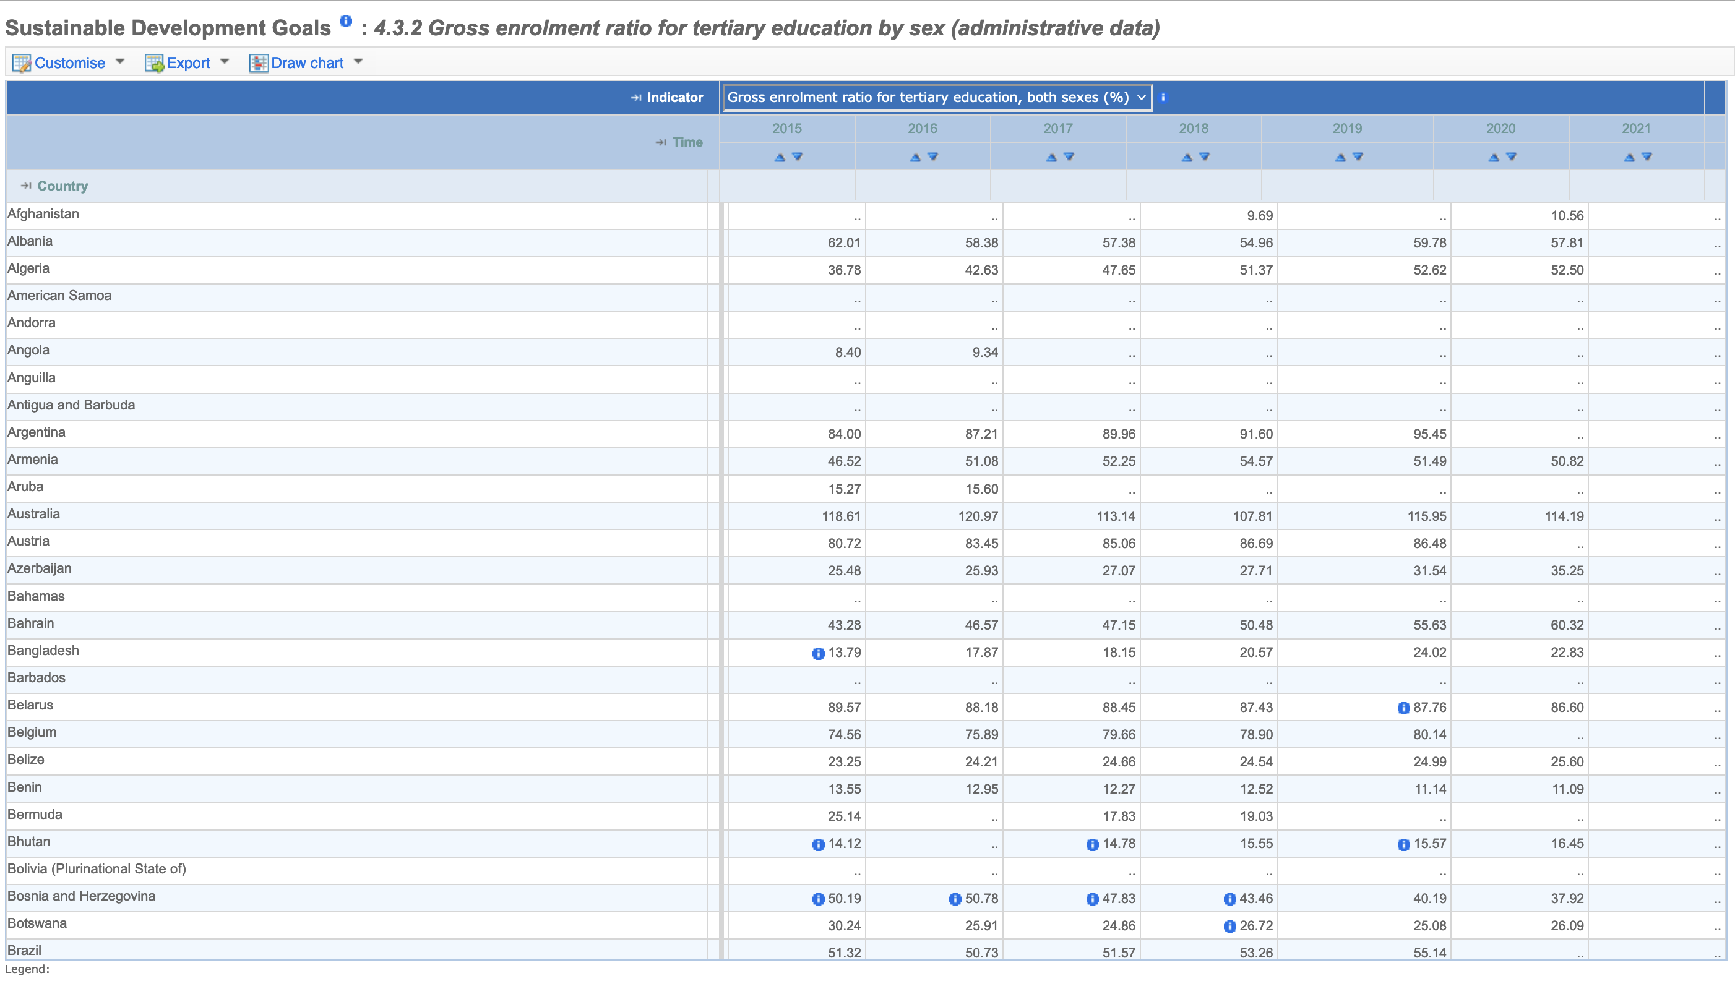
test

Slide 9
35%
2015
2016
2017
2018
2019
2020

Slide 10
35% continue education after secondary

Slide 11
40% of population under 24 years old
23% of youth are employed
1 million

Slide 12
Companies not hiring because of lack of skill.

Slide 13
Companies not hiring because of lack of education.

Slide 14
Big problem.

Slide 15
Solution?
Gamify education.

Slide 16
Solution?
Gamify education.
Make education fun and addictive.

Slide 17
What games are fun and addictive?

Slide 18








What games are fun and addictive?

Slide 19
Competitive
Rewarding
In-Game Purchases
Levels
Friends
Repeatability
Repeatability
Friends
Increasing Difficulty
Repeatability
Competitive
Rewarding
In-Game Purchases
Levels
Friends
Competitive
Rewarding
In-Game Purchases
Levels
Friends
Repeatability
Repeatability
High Difficulty
Competitive
Rewarding
In-Game Purchases
Levels
Friends
Repeatability
Competitive
Friends
Repeatability
High Difficulty

Slide 20
Competitive
Rewarding
In-Game Purchases
Levels
Friends
Repeatability
Repeatability
Friends
Increasing Difficulty
Repeatability
Competitive
Rewarding
In-Game Purchases
Levels
Friends
Competitive
Rewarding
In-Game Purchases
Levels
Friends
Repeatability
Repeatability
High Difficulty
Competitive
Rewarding
In-Game Purchases
Levels
Friends
Repeatability
Competitive
Friends
Repeatability
High Difficulty

Slide 21
Competitive
Rewarding
In-Game Purchases
Levels
Friends
Repeatability

Slide 22
Do quizzes.
Quizzes reward with points and experience.
Points for in-game purchases.
Experience for levels.
Level up core skills for your desired field.
Match your skillset with your desired job skillset.
Competitive
Rewarding
In-Game Purchases
Levels
Friends
Repeatability

Slide 23
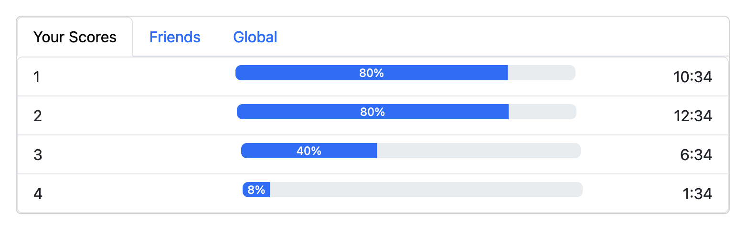
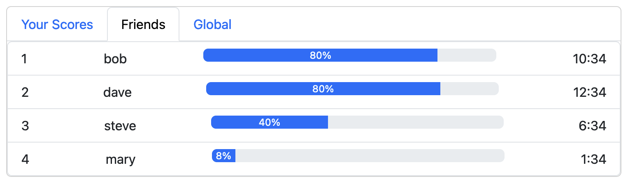
Competitive
Rewarding
In-Game Purchases
Levels
Friends
Repeatability
Notes:
Picture of scoreboard.

Slide 24
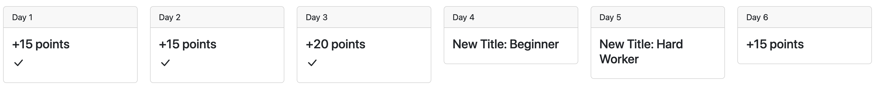
Competitive
Rewarding
In-Game Purchases
Levels
Friends
Repeatability

Slide 25
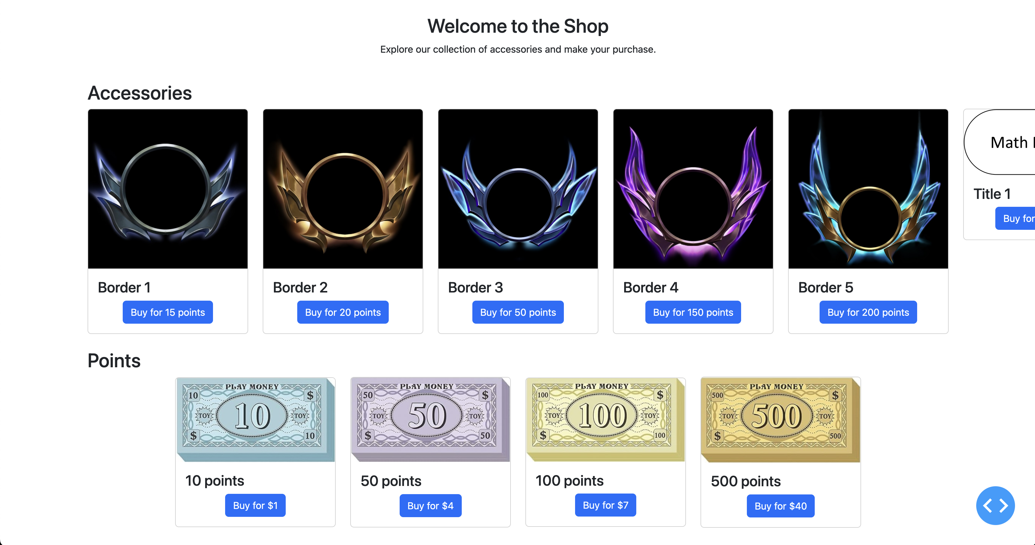
Competitive
Rewarding
In-Game Purchases
Levels
Friends
Repeatability

Slide 26
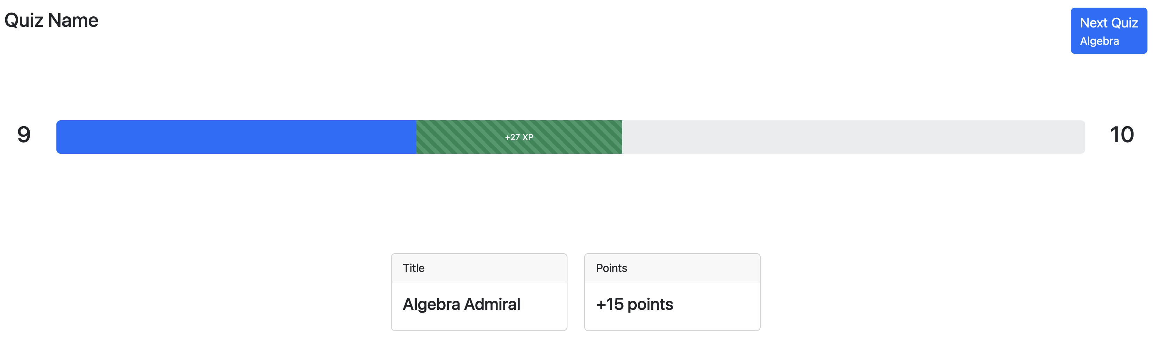
Competitive
Rewarding
In-Game Purchases
Levels
Friends
Repeatability

Slide 27
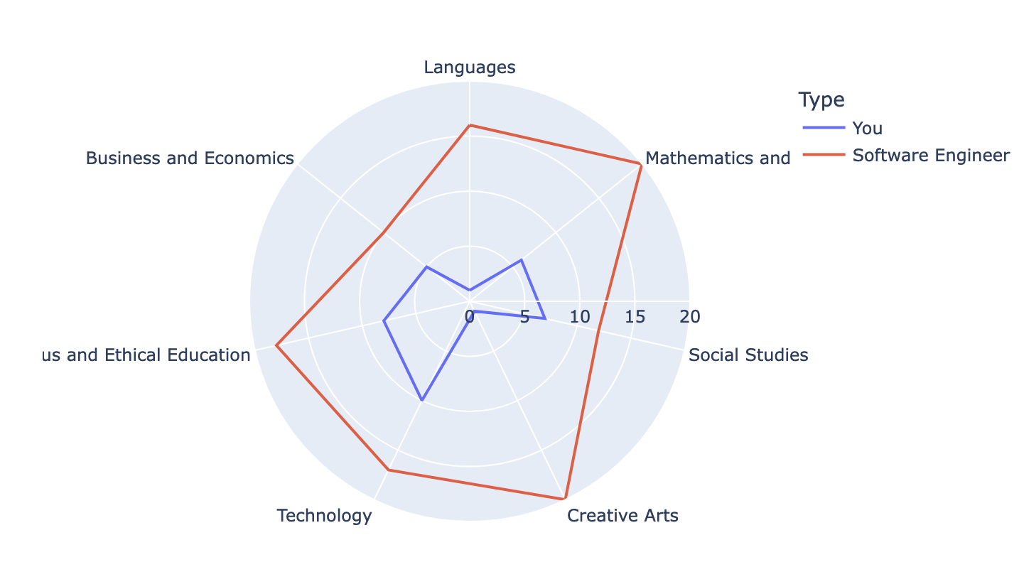
Where they are
Where they want to be

Slide 28
Quizi

Slide 29
Quizi
How does it make money?

Slide 30
Quizi
1. Business to Business
2. Direct to Consumer

Slide 31
Quizi
1. Business to Business
2. Direct to Consumer
Sell to schools
They control the quizzes, in-game purchase items, etc.
They take a percentage of the revenue
Gives money back to schools
Schools can improve
Free app for consumers
Make money from in-game purchases

Slide 32



Team
Ben
Snellgrove
Kumar
Acharjee
Kaleem
Peeroo

Slide 33
Quizi
Questions?

